Slide 1


Slide 2

NAME
OF
OUR
TOPICS
SOCIAL MEDIA

Slide 3

CONTENTS:
What is Social Media?
Purpose of Social Media.
List of social networking sites.
Purpose of Social Media.
Some features of social media.
Effect of social media on students/ youth!
Positive Effect of Social media.
Negative Effect of Social media

Slide 4

What Is Social Media?
Computer based technology that facilitates the share of ideas, Thoughts and Information through The Building Of Virtual Network And Community.
Social Media is an Online Platform Where we Can Share Our Thoughts , information ,Pictures And Videos.
We All Use It In Day To Day Life.
It has become an Integral Part Of Our Lives.

Slide 5


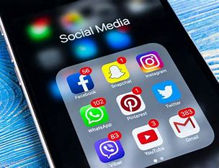
Popular Applications of Social Media:
Google
Chatgpt
WhatsApp
Facebook
Instagram
Google Maps
YouTube
Snapchat
Telegram
Gmail

Slide 6

Purpose of Social Media:
Checking of applications
Finding information
Sending and receiving e-mail
Downloading
Music listening
Shopping
Chatting

Slide 7

Positive Effects Of social media:
Communication made easy
Lot of Entertainment
Develop communications skills and improve knowledge
Online (education hopping booking and money transactions etc.)
Use of social media promotions and advertising
People can connect through social media
Social media is a good source of up to date information

Slide 8


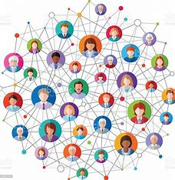
You reach large audiences.
You have a direct connection with your audience.
You can create organic content.
You build your brand.
You can create viral content

Slide 9

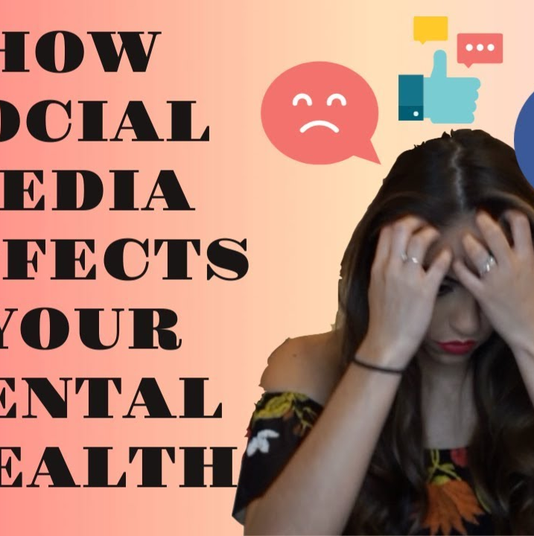

Negative Effects of Social Media:
Privacy.
Cyberbullying.
People's Addiction to social media.
Reduces Face-to-face Communication skills.
Spending Time on Social Media is a Waste of Time
Social media cause Depression and sleep issue.
Social media cause Distraction.
You can receive negative feedback.

